Slide 1
DL2.0 Bootcamp
Object Detection
By Kingsley Kuan

Slide 2
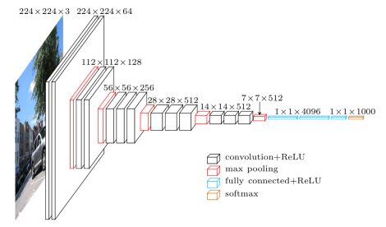
CNNs for Image Classification
Can we reuse image classification CNNs for object detection?

Slide 3
Repurposing a CNN for Object Detection
What if we chop the last layers off an image classification CNN?
Problem: This feature map is implicitly learned during training
0 | 1 | 0 | 0 | 1 | 1 | 0
1 | 1 | 0 | 1 | 0 | 0 | 0
1 | 1 | 1 | 1 | 1 | 0 | 0
0 | 1 | 1 | 0 | 1 | 0 | 1
1 | 0 | 0 | 0 | 0 | 1 | 1
0 | 0 | 1 | 1 | 0 | 1 | 0
0 | 0 | 1 | 1 | 1 | 1 | 0

Slide 4
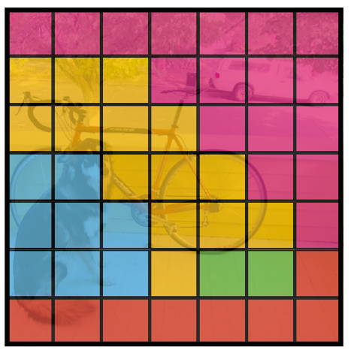
CNNs for Object Detection - Object Classes
Solution: Explicitly redefine the target output during training
Groundtruth consists of a (m x n) score map where each feature map cell contains (1, ..., c) class scores
Output of network becomes a (m x n x c) feature map
Ie. Network predicts score of an object class occurring at the associated position in the image
Use standard cross entropy loss for each feature map cell

Slide 5
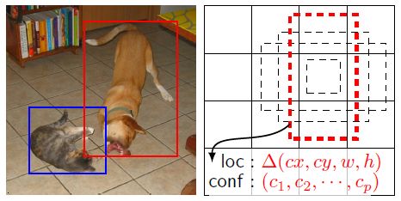
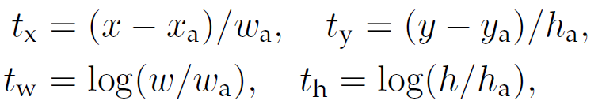
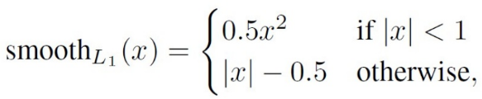
CNNs for Object Detection - Object Bounding Box
Define additional outputs to refine the shape of the object's bounding box by:
Adding more default bounding box sizes to each feature map cell
These are known as anchors or default boxes in different frameworks
Compute regression targets relative to default boxes that closely match groundtruth bounding boxes
Output of network becomes a (m x n x k x (c + 4)) feature map
Use smooth L1 loss to optimize regression

Slide 6
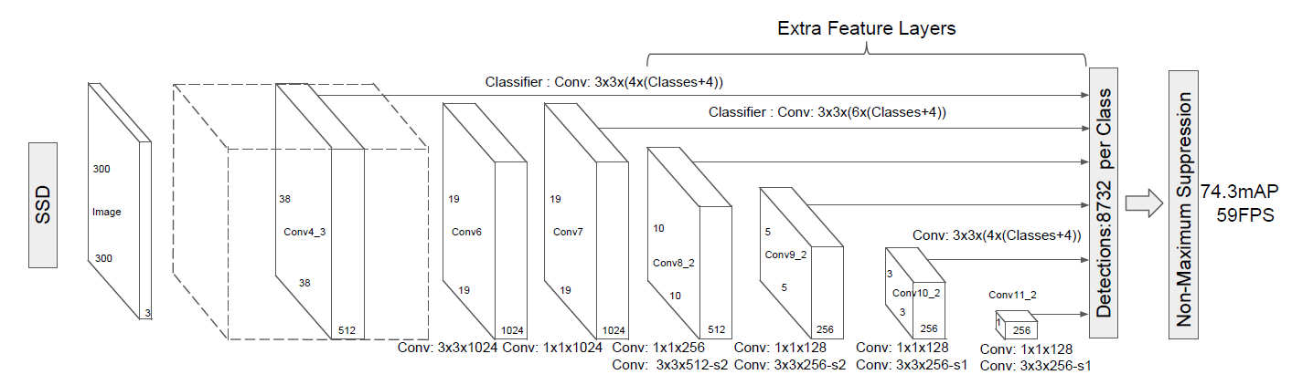
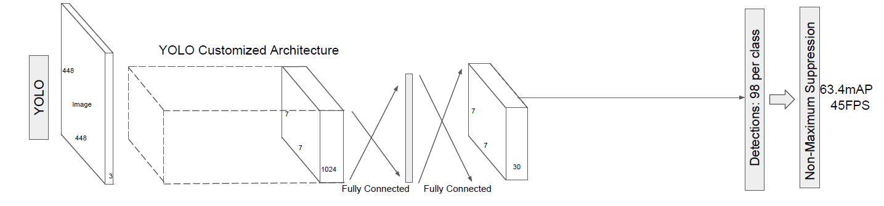
Frameworks I - Speed over Performance
SSD - Produces outputs directly from feature maps of different scales
YOLO - Uses fully connected layer before final output feature map

Slide 7
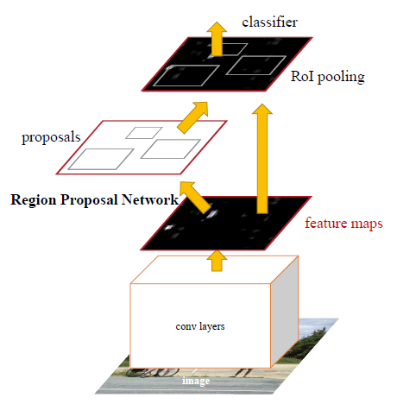
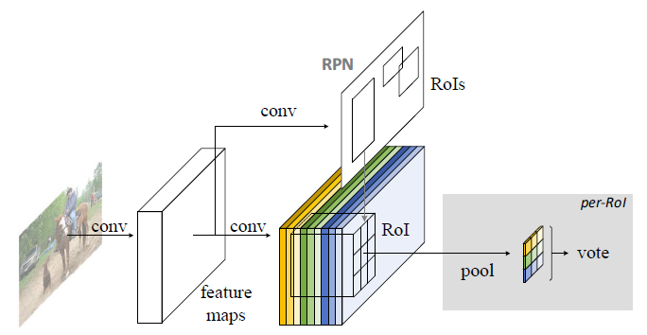
Frameworks II - Performance over Speed
Faster-RCNN - Network branches into two:
Region proposal network proposes ROIs with 2 classes (object / no object)
Classifier layers classifies features cropped and scaled to a fixed size using proposals
R-FCN - Uses region proposal sub-network but only uses it to pool from position sensitive output feature map

Slide 8
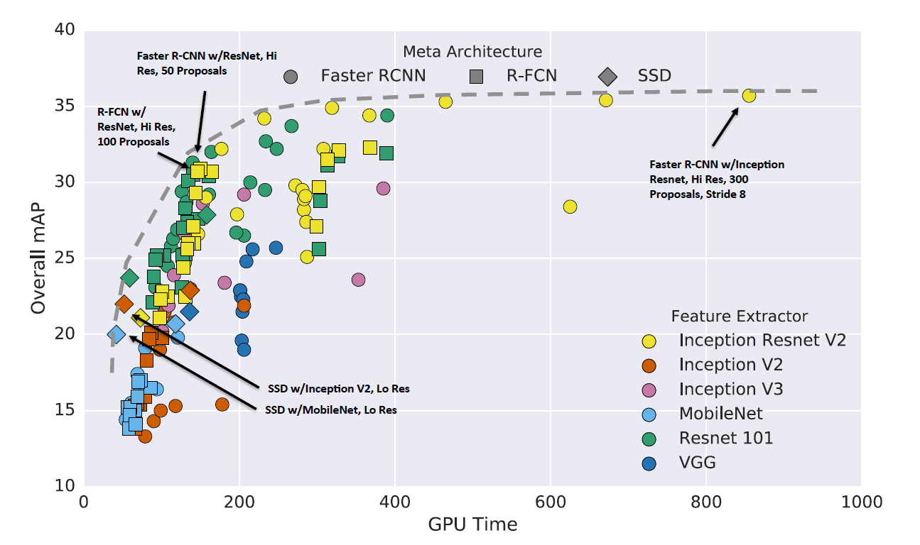
Frameworks III
Use any image classification CNN as base of the framework
Mix and match different base CNNs and frameworks for speed-accuracy trade-offs

Slide 9
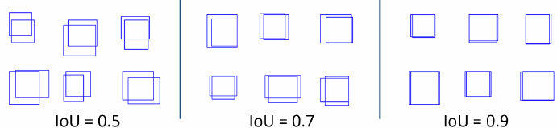
Additional Techniques
Anchors / Default Boxes can be manually defined or discovered through clustering groundtruth bounding boxes
Significant imbalance between negative and positive feature map cells can be addressed through proper sampling during training
Match between two boxes can be computed with intersection over union (iou)

Slide 10
Code Walkthrough
Applying object detection to Kitti dataset (autonomous driving images)
Code is based on a very simplified version of SSD+ResNet-18 with only one default box per feature map cell and one feature map scale

Slide 11
References
Liu, Wei, et al. "Ssd: Single shot multibox detector." European conference on computer vision. Springer, Cham, 2016. https://arxiv.org/pdf/1512.02325.pdf
Redmon, Joseph, et al. "You only look once: Unified, real-time object detection." Proceedings of the IEEE Conference on Computer Vision and Pattern Recognition. 2016. https://arxiv.org/pdf/1506.02640.pdf
Ren, Shaoqing, et al. "Faster R-CNN: Towards real-time object detection with region proposal networks." Advances in neural information processing systems. 2015. https://arxiv.org/pdf/1506.01497.pdf
Li, Yi, Kaiming He, and Jian Sun. "R-fcn: Object detection via region-based fully convolutional networks." Advances in Neural Information Processing Systems. 2016. https://arxiv.org/pdf/1605.06409.pdf
Huang, Jonathan, et al. "Speed/accuracy trade-offs for modern convolutional object detectors." arXiv preprint arXiv:1611.10012 (2016). https://arxiv.org/pdf/1611.10012

